Slide 1

AWS Snow Family

Slide 2
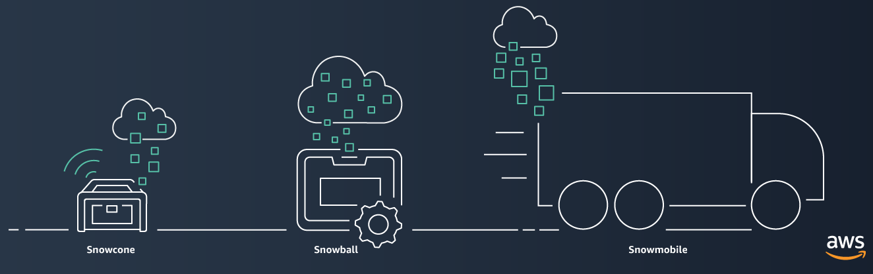
Snow Family

Slide 3
Use Cases
Large data transfer during cloud migration.
On-premises data backup for disaster recovery.
Data center relocation and/or remote data collection.
Physically isolated environment where high-speed Internet connections are not available.

Slide 4
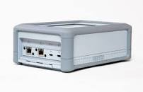
AWS Snowcone
AWS Snowcone is a small, rugged, and secure edge computing and data migration device.
AWS Snowcone HDD features 8 TB of usable storage, and AWS Snowcone SSD features 14 TB of usable storage. Applications can work with both Snowcone devices as an NFS v4 mount point.
You can easily use Snowcone with your existing on-premises servers and file-based applications to read and write data on the device.

Slide 5

AWS Snowball
AWS Snowball
Petabyte-scale data transport
Can transport multiple terabytes of data into or out of Amazon S3
Multiple devices can be used to transfer petabytes
Addresses concerns of large data transfers (network costs, transfer times, security)
Example: To transfer 10 petabytes (10 million GB) over the internet with a 10 Gbps upload speed would take over 100 days
AWS Snowball
Notes:
AWS Snowball is a petabyte-scale data transport option that doesn’t require you to write any code or purchase any hardware to transfer your data. All you need to do is create a job in the AWS Management Console, and a Snowball appliance will be shipped to you. Attach the appliance to your local network and transfer files directly onto it. Then, ship it back and track the status of your shipment. When it arrives at the secure Amazon facility, the data will be transferred into your AWS account.

Slide 6
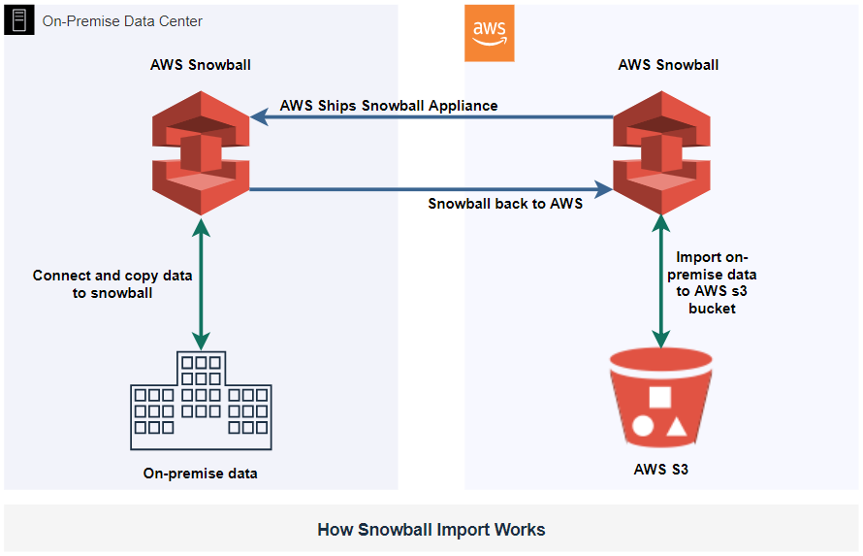
AWS Snowball
Notes:
To use
Create a job in the AWS Management Console and a Snowball will be shipped to you.
Attach to your local network, then download and run the Snowball Client
Select the file directories to transfer (encrypted) to the device
Ship the device back and track the status

Slide 7
AWS Snowball Edge
Snowball Edge is a 100TB data transfer device with AWS computing and storage capabilities.
Snowball Edge device comes with two options: Compute Optimized and Storage Optimized.
Snowball Edge Storage Optimized: This device provides around 24 vCPUs with 80 TB of usable block or object storage.
Snowball Edge Compute Optimized: This device provides around104vCPUs, 42 TB of usable block or object storage and an optional GPU.
AWS Snowball Edge Features
It supports to write and run Lambda functions.
It allows you to cluster Snowball Edge devices for local storage and compute jobs to achieve 99.999% data durability across 5–10 devices and also ensures to run your application locally, even when they are not able to access the cloud.
It provides a file interface to read and write data to an AWS Snowball Edge device through a file share or Network File System (NFS) mount point.

Slide 8

AWS Snowmobile
AWS Snowmobile
Exabyte-scale data transport
A 45-foot-long (13.7 meters) shipping container, pulled by a semi-trailer truck
Can transfer up to 100 PB per Snowmobile
Offers multiple layers of security –
Dedicated security personnel
GPS tracking, alarm monitoring, 24/7 video surveillance
Optional escort security vehicle while in transit
Data encrypted with 256-bit encryption keys
AWS Snowmobile
Notes:
AWS Snowmobile is an even larger data transfer option that operates in exabyte scale. An exabyte is 1 million terabytes or 1 billion gigabytes. It should only be used to move extremely large amounts of data into AWS. A Snowmobile is a 45-foot-lonf (13.7 meters) ruggedized shipping container that is pulled by a semi-trailer truck. You can transfer 100 PB per Snowmobile.
If you tried to transfer 100 petabytes of data over the internet, with an upload speed of 10 Gbps (assuming a TCP/IP overhead of 10%), it would take approximately 1018 days (almost three years) to finish uploading the data. That would not be practical. In such cases, using AWS Snowmobile to transfer the data would be a better option.
Snowmobile uses multiple layers of security designed to protect your data, including dedicated security personnel, GPS tracking, alarm monitoring, 24/7 video surveillance, and an optional escort security vehicle while in transit. All data is encrypted with 256-bit encryption keys managed through AWS Key Management Service (AWS KMS) and designed to ensure both security and full chain-of-custody of your data.

Slide 9
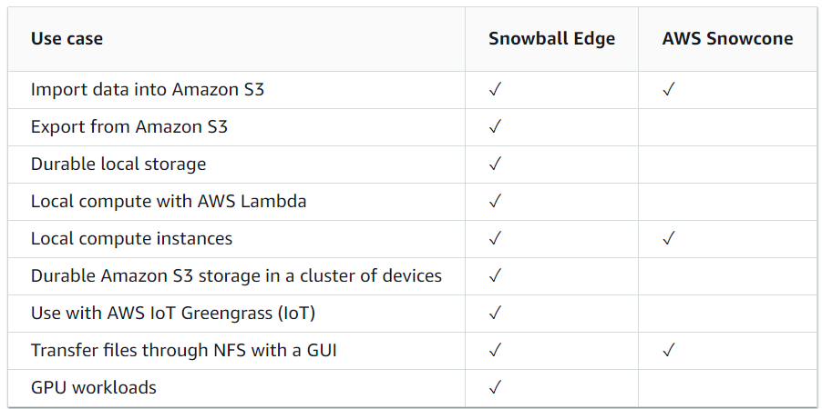
When do I use Snowcone or Snowball Edge ?

